Slide 1
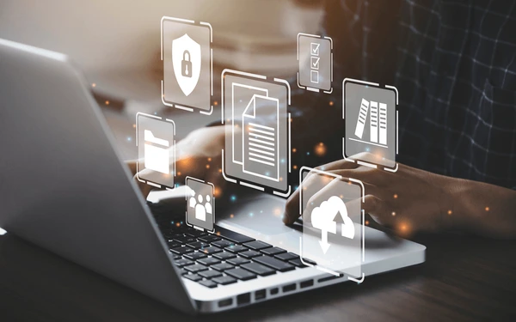
Introduction to Computing Systems

Slide 2
Objectives
01
03
02
Read and comprehend the meaning of the terms related to computer components;
Differentiate present simple in the active and passive voice;
discuss the principles, challenges, and applications of computing systems looking at some case studies.

Slide 3
Lead-in:
1. What is the relevance and importance of computing systems in modern society? (for communication, education, business, healthcare, etc.)
2. How do computing systems impact various aspects of our lives, from personal use to business applications?

Slide 4
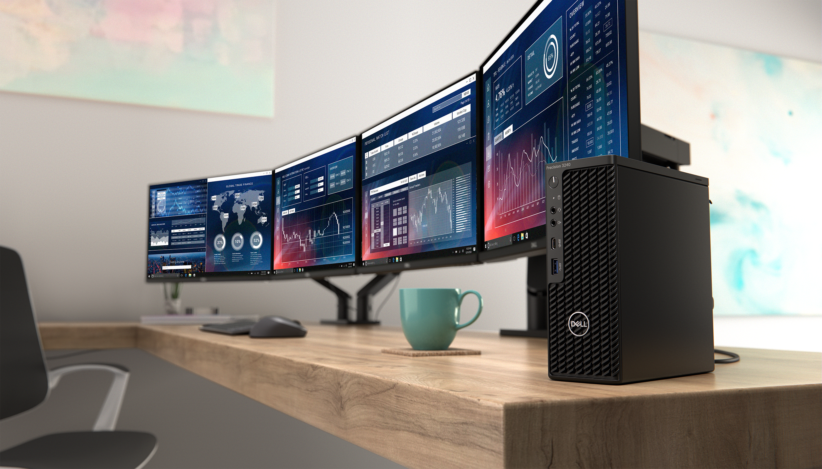
Workstation
a very fast computer that runs powerful work programs.

Slide 5
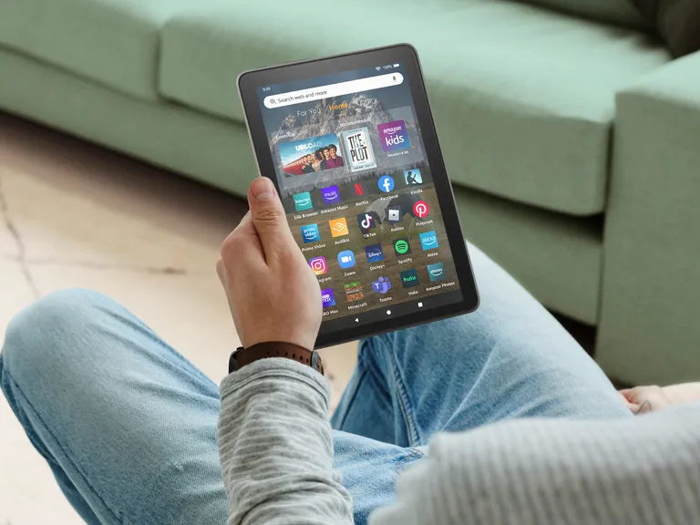
Tablet
a computer that is smaller than a laptop with a touch screen and used to browse the Internet and check email.

Slide 6
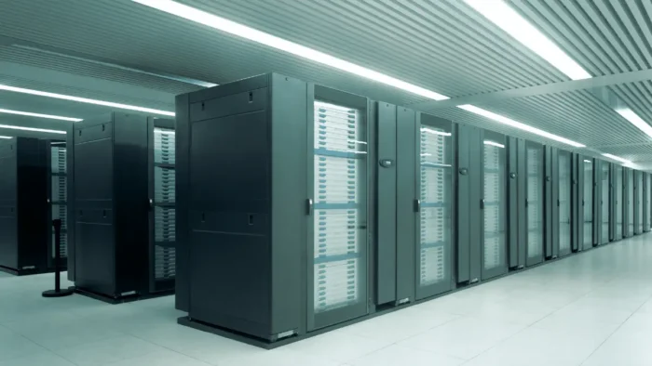
Mainframe
a very powerful computer that can process large amounts of data.

Slide 7
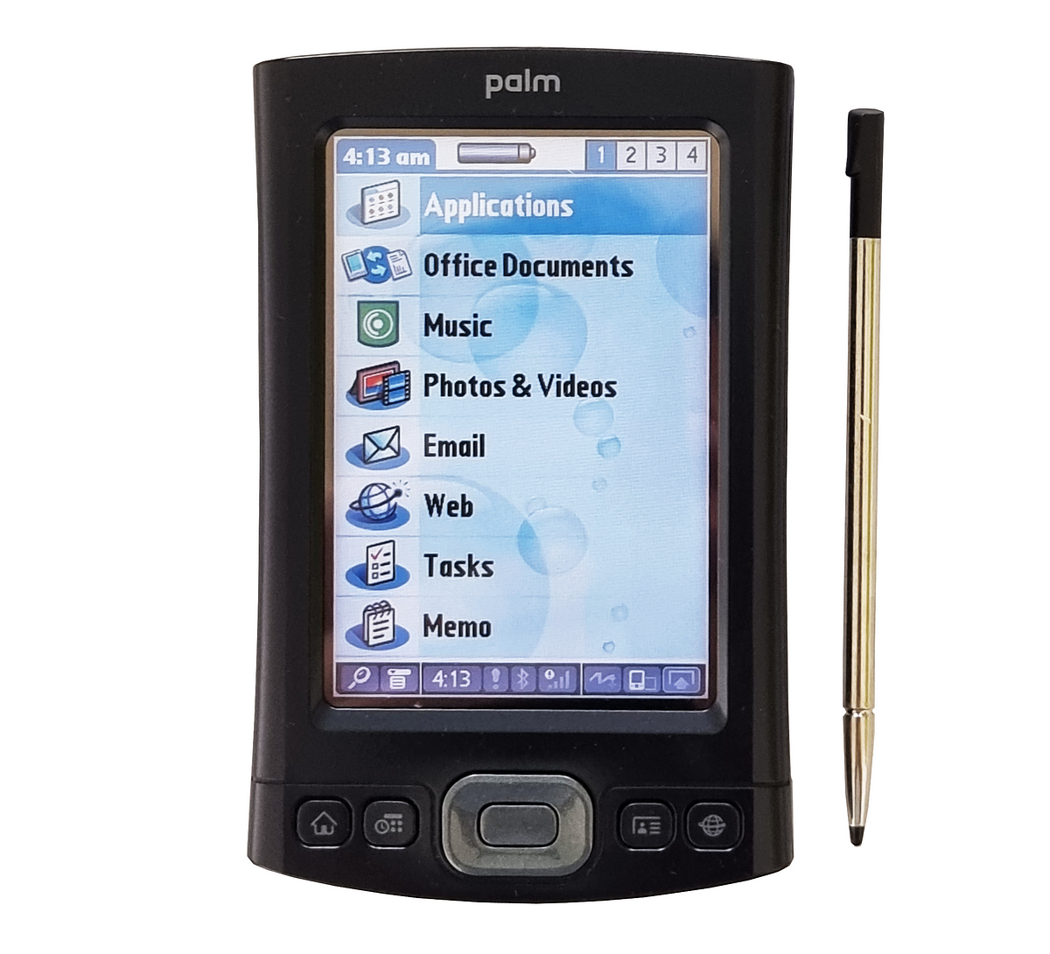
PDA
A PDA (Personal Digital Assistant) is a small computer that is used to organize a person's schedules and information.

Slide 8
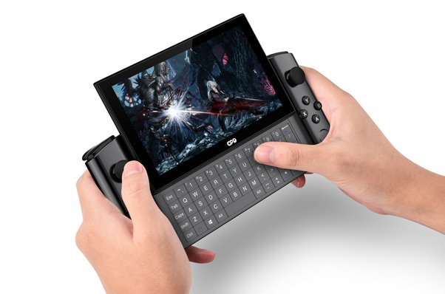
Handheld PC
A handheld PC is a computer that is smaller, slower and less powerful than a laptop and used to browse the Internet and check email.

Slide 9
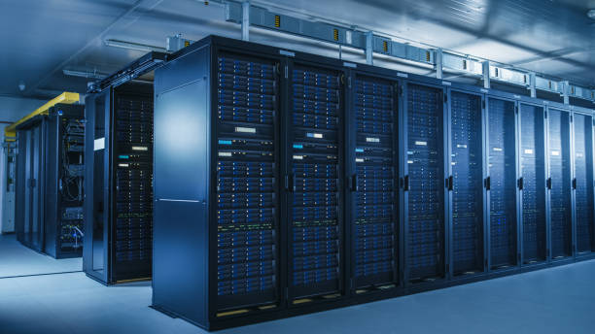
Server
A server is a computer that connects many computers to hardware.

Slide 10
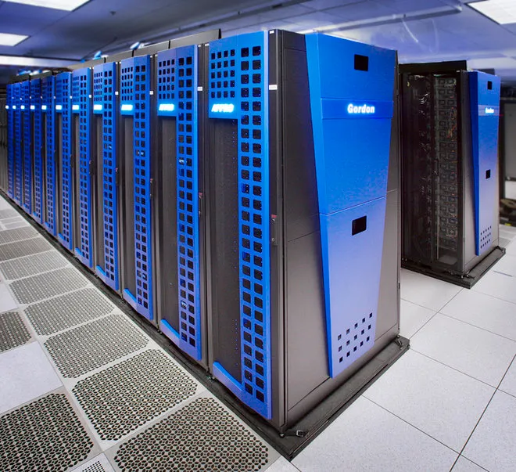
Supercomputer
A supercomputer is a large computer that is built to process large amounts of information at a higher speed than other computers can handle.

Slide 11
Read the sentences and choose the correct word
1. My (tablet/mainframe) notifies me when I have a meeting.
2. I have a (laptop/ supercomputer) to do work on the plane.
3. John has a (server/ desktop computer) because he only uses simple programs.
4. This (computer/server) runs programs but doesn’t have Internet access.
5. A (workstation/ tablet) is smaller than a laptop but still has a keyboard.
6. Connect to the (server /laptop) to use that printer.
7. A (supercomputer/tablet) is the most powerful machine in the world.

Slide 12
Match the words with the definitions (A-C)
smartphone | mainframe | workstation
A. large and powerful computer that supports many other computers working at once _________
B. fast computer that is used by one person and has more memory than an ordinary personal computer _______
C. a device that makes and receives calls and can connect to the Internet ___________
mainframe
workstation
smartphone

Slide 13
Grammar
In passive voice, the present simple tense is used to describe actions that are performed on the subject by an unspecified or unknown agent (person). This can be helpful when discussing general processes or actions without specifying who is performing them.
Example:
Active Voice: The program compiles the code every hour.
Passive Voice: The code is compiled every hour.
In this example, the focus is on the action of compiling, and the subject “the code” becomes the object in the passive construction. This helps computer science students understand how tasks are completed within a system without needing to specify the person (actor) carrying out the action.

Slide 14
Structure: to be (am, is, are) + Past Participle
Present Simple in Active Voice:
Affirmative sentence | Negative sentence | Interrogative sentence
I (you, we, they) load the computer every day. She (he, it) loads the computer every day. | I don’t load the computer every day. She doesn’t load the computer every day. | Do you load the computer every day? Does she load the computer every day?

Slide 15
Structure: to be (am, is, are) + Past Participle
Present Simple in Passive Voice:
Affirmative sentence | Negative sentence | Interrogative sentence
I am asked to load the computer every day. You (we, they) are asked to load the computer every day. She (he, it) is asked to load the computer every day. | I am not asked to load the computer every day. You (we, they) are not asked to load the computer every day. She (he, it) is not asked to load the computer every day. | Am I asked to load the computer every day? Are you (we, they) asked to load the computer every day? Is she (he, it) asked to load the computer every day?

Slide 16
Convert the sentences from Active to Passive or Passive to Active
Active: The developer writes the code. Passive: The code ______ by the developer.
Active: The IT team maintains the server. Passive: The server ______ by the IT team.
Passive: The emails are sent automatically. Active: The system ______ the emails automatically.
Active: The software engineer tests the program. Passive: The program ______ by the software engineer.
is written
is maintained
sends
is tested

Slide 17
Activity
Write the correct form of the verbs and complete the sentences
RAM ……. (store) temporary data in the computer, while expansion cards ………. (enhance) its capabilities. 2. Mainframes ……… (utilize) by large organizations for their powerful computing needs. 3. Workstations ………. (use) by professionals for their high-performance capabilities. 4. Tasks ………. (execute) quickly by the processor, and data ……. (store) on the hard drive, while all components ……… (connect) by the motherboard.
Answers: 1. stores/ enhance. 2. are utilized. 3. are used. 4. are executed/ is stored/ are connected

Slide 18
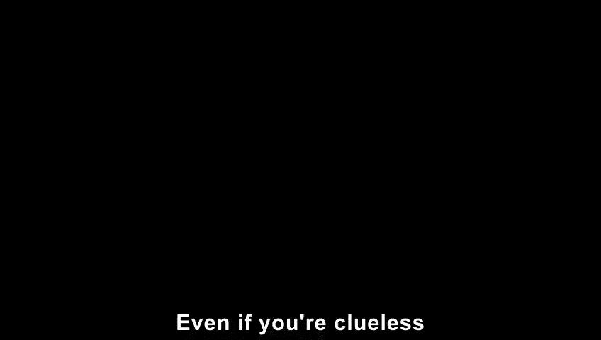
Watch a video & answer the questions

Slide 19
Mark the following statements as True or False
Relative to their cost, desktops have the most amount of power, speed, storage and upgradeability.
True
False
2. Laptops are the easiest to upgrade and repair.
True
False
3. Desktops have a lot of cables and are not as portable as laptops.
True
False
4. The most common Mac people purchase is the iMac.
True
False
5. Laptops called ‘desktop replacements’ are not as powerful as their desktop counterparts.
True
False
6. Tablets are designed to be network-based devices.
True
False

Slide 20

Listen to a conversation between an IT professional and a new employee. Choose the correct answers.
1. Which of the following computers are NOT shared by employees at TEI Inc.?
A. the server
B. workstations
C. laptops
D. desktop computers
2. According to the dialogue, employees use the server to ... .
A. open programs
B. reserve workstations
C. log onto desktop computers
D. borrow laptops

Slide 21
Case Study on Smart Home Security
Smart Home Systems leverage computing technology to provide homeowners with advanced control over various aspects of their living environment, such as lighting, temperature, security, and appliances. These systems typically incorporate a combination of sensors, actuators, communication devices, and centralized control units to automate and manage home functions.
Principles:
1. Interconnectivity 4. User Interface
2. Monitoring and Control 5. Integration
3. Data Analysis

Slide 22
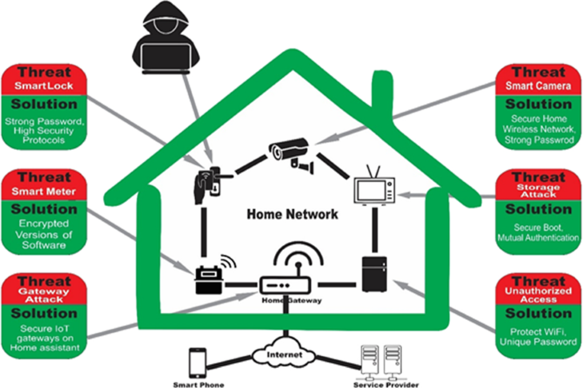
Challenges:
1. Interoperability
2. Data Security
3. Reliability
4. Complexity

Slide 23
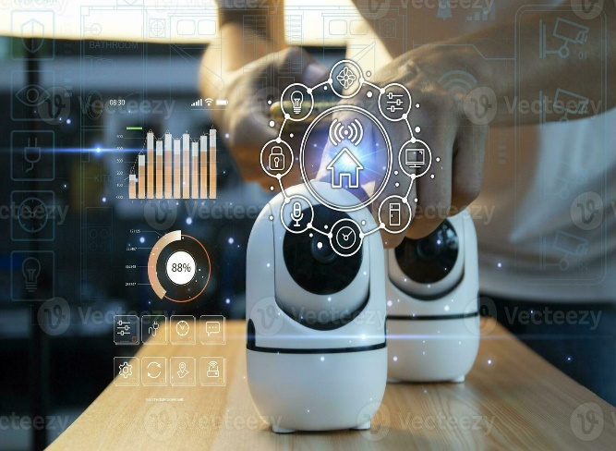
Applications:
1. Energy Efficiency 3. Convenience and Comfort
2. Home Security 4. Health Monitoring
5. Home Automation

Slide 24
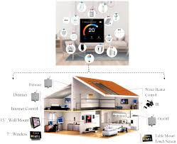
Group Activity:
Discuss and describe some case study examples covering various aspects of computing systems. Provide the principles, challenges, and applications of chosen technologies’ computing systems.

Slide 25
Homework
Write a summary of the chosen computing technology by providing the principles, challenges, and applications.

Slide 26


Slide 27
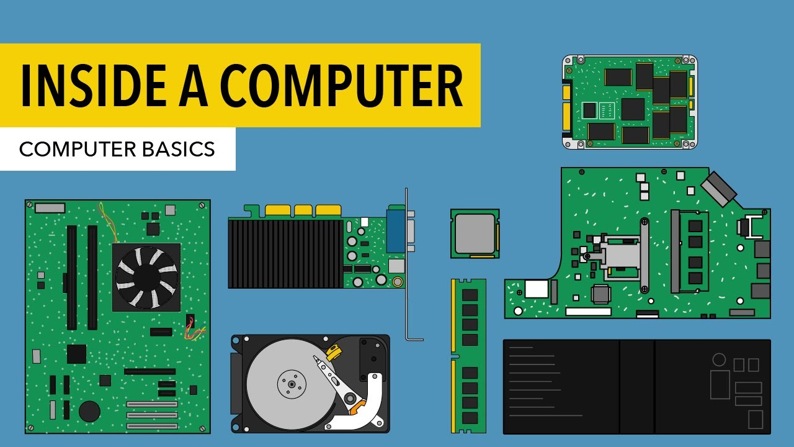
Inside the computer

Slide 28
Objectives:
Identify and describe the primary internal components of a computer;
1.
3.
2.
Read and comprehend the meaning of the terms related to computer components;
Use target vocabulary in speaking and writing.

Slide 29
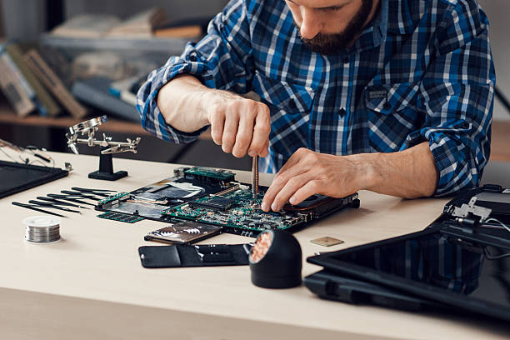
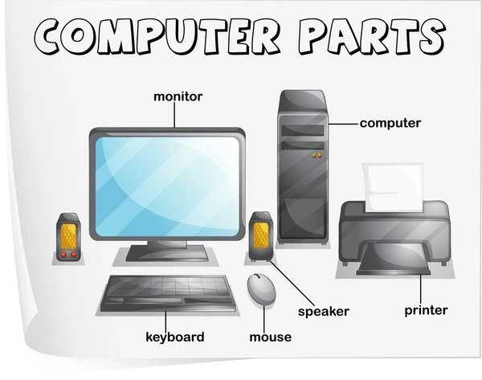
Get Ready!
1. Which components make up a typical desktop computer?
2. What do you call a person who repairs computers?

Slide 30
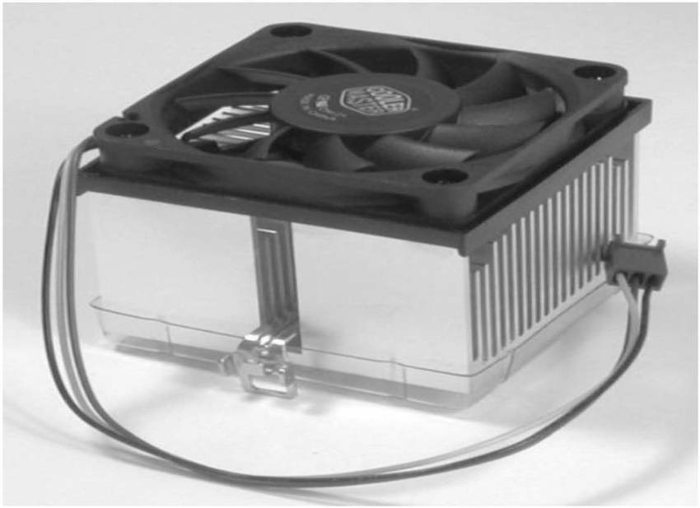
Heat sink
it transfers heat away from the processor in the computer.

Slide 31
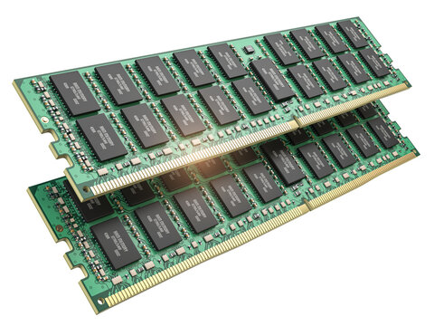
RAM
(Random Access Memory) is a memory that can be quickly accessed.

Slide 32
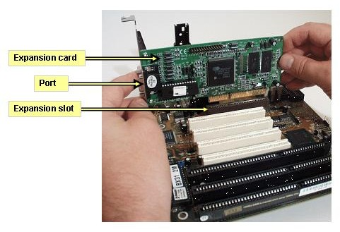
Expansion cards
extra circuit boards that are used to increase the functions of a computer.

Slide 33
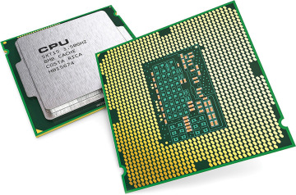
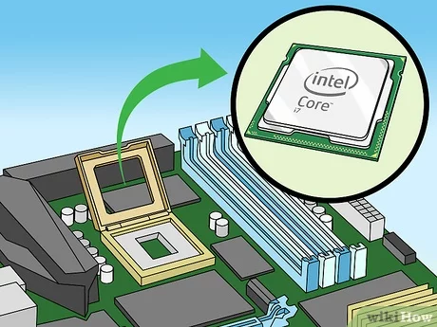
Processor
holds the instructions of computer programs.

Slide 34
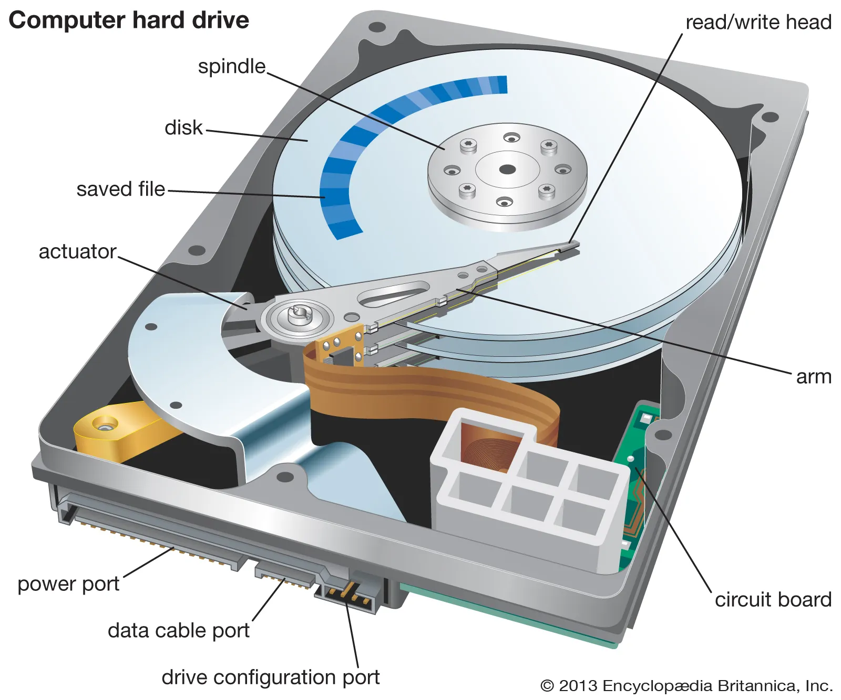
Hard drive
equipment that stores data electronically.

Slide 35
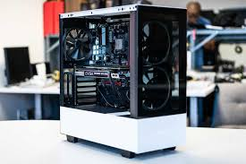
Case
an enclosure that holds the computer’s components.

Slide 36
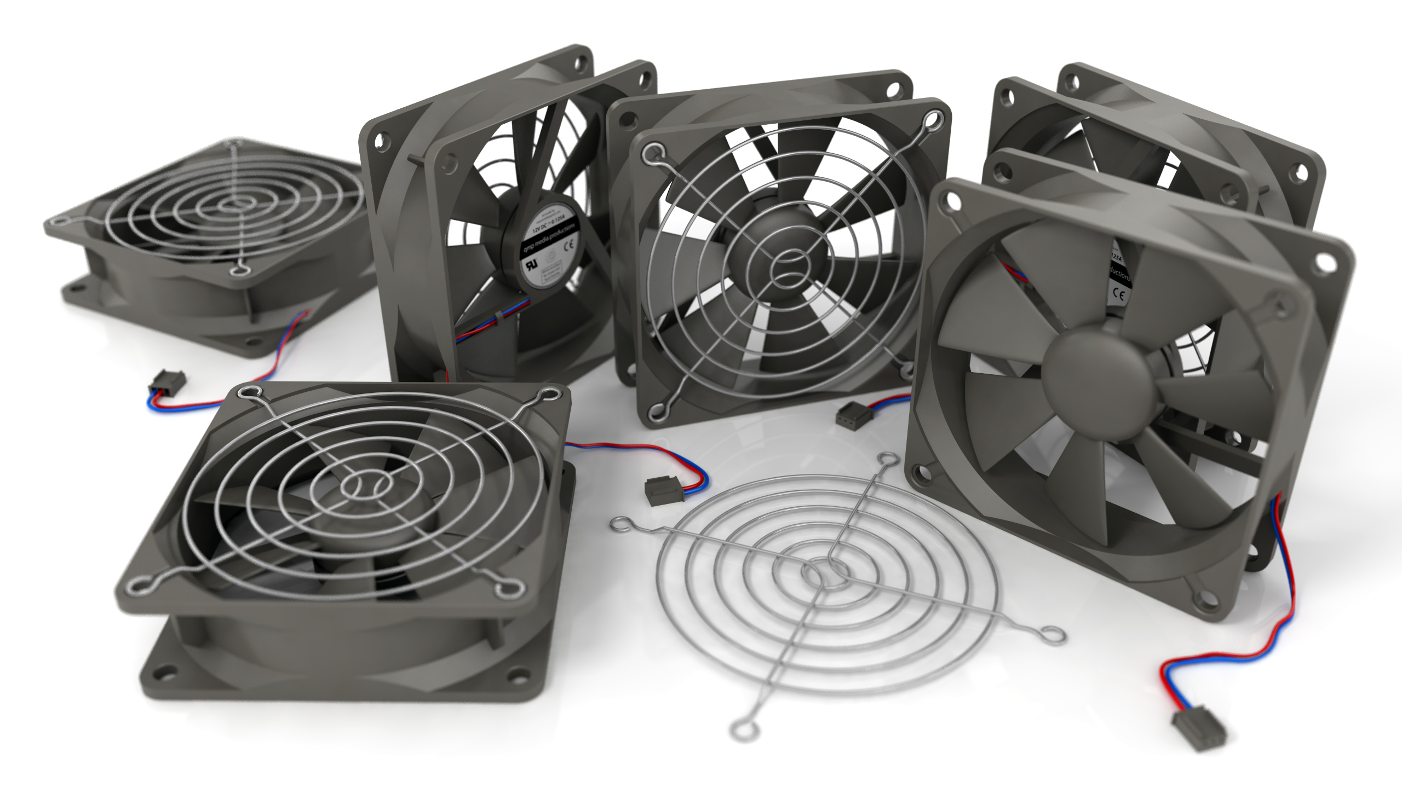
Fan
an equipment that moves cool air onto computer components inside the case.

Slide 37
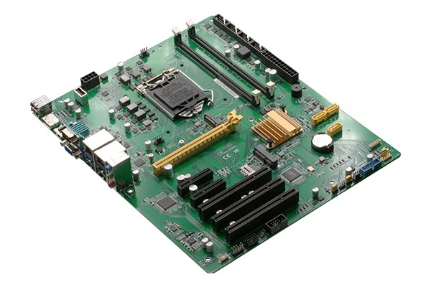
Motherboard
a firm slotted board onto which computer circuitry is attached.

Slide 38
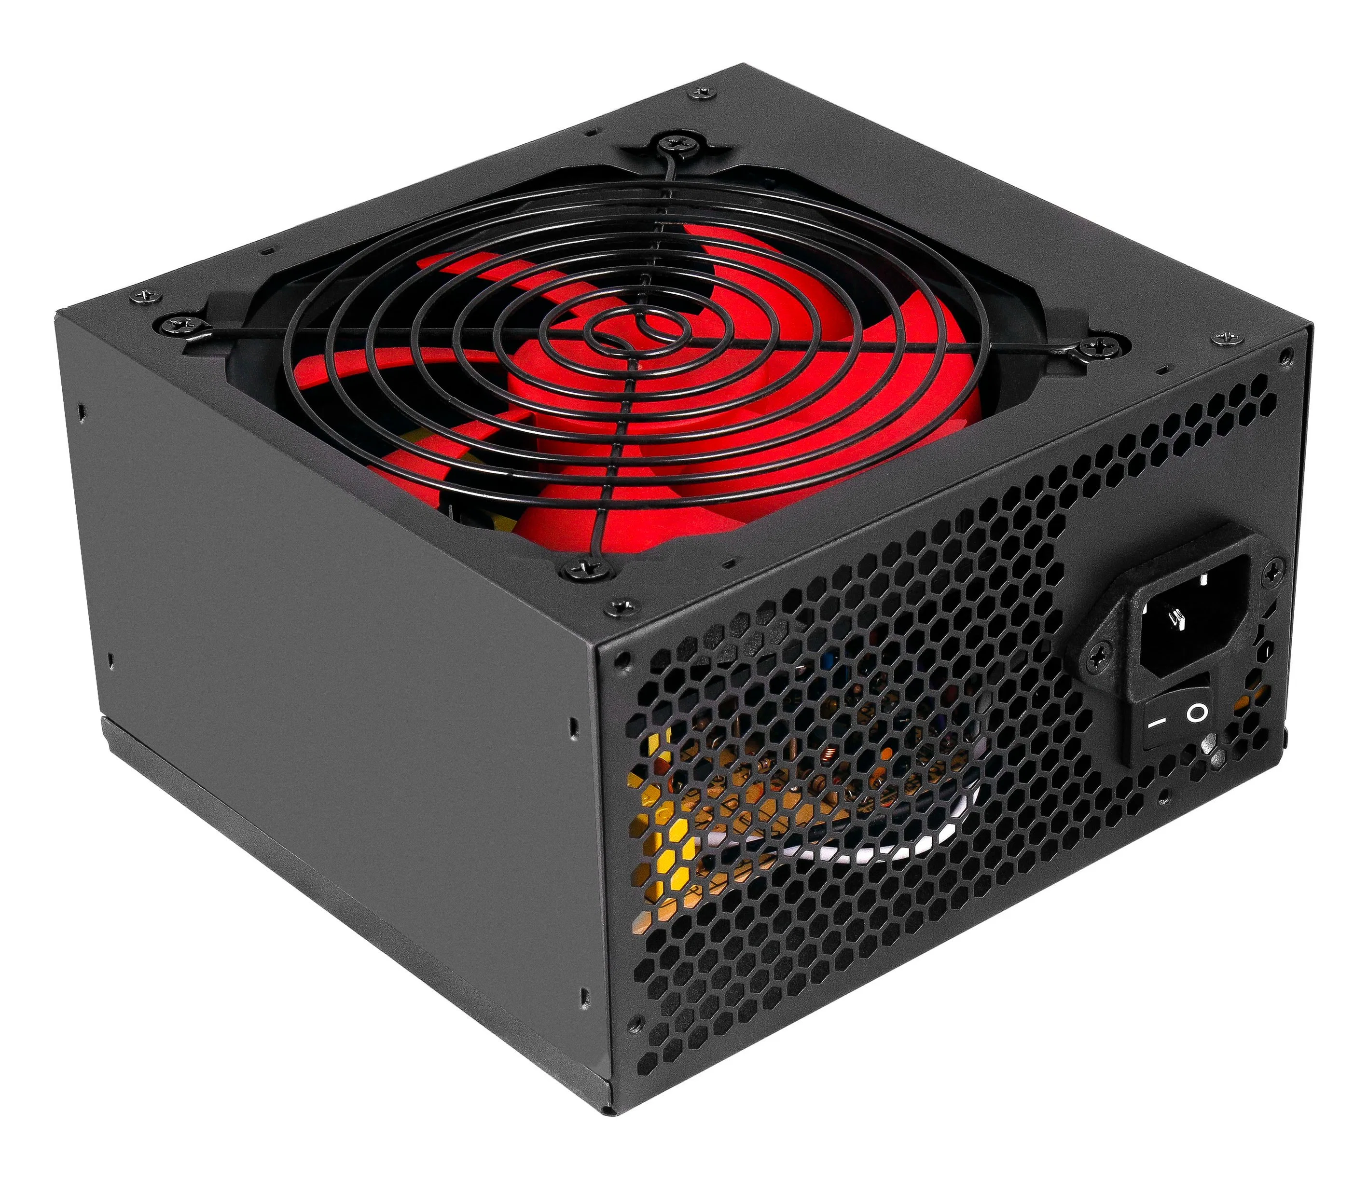
Power supply
it delivers electricity to all parts of a computer.

Slide 39
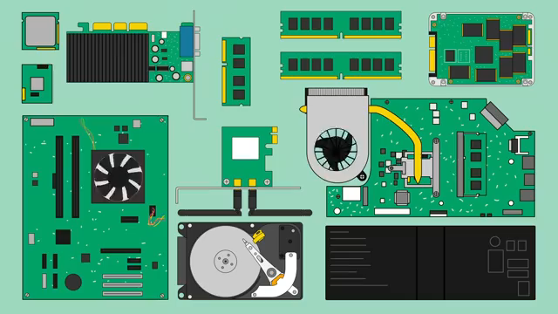
Activity:
Watch a video about “Inside a computer” and write the main components of a computer as many as you hear.

Slide 40
Activity:
Write a word that is similar in meaning to the underlined part.
1.The central processing unit in the data center processes large volumes of information. m_ _ _ _ _ _ _ _.
2.Spinning blades keep the computer from overheating. f _ _.
3.Joey purchased a protective bag for his computer. _ a _ _ .
4.The technical staff gathered around the desktop computer to collaborate on the project.
_ o _ _ s _ _ _ _ _ _.
5.Make sure to back up your important files regularly on the disk drive.
_ _ _ d d _ _ _ _.
ma i n f r a m e
f a n
c a s e
w o r k s t a t i o n
h a r d d r i v e

Slide 41
Match the words with the definitions (A-F)
heat sink | motherboard | hard drive | RAM | expansion card | processor
A. a slotted board with circuits and ports __________
B. a short-term, quick memory source __________
C. a part used to cool the processor __________
D. a part used to store large amounts of data ________
E. a part used to increase a computer’s functions ___
F. a part that completes tasks for the computer _________
motherboard
RAM
heat sink
hard drive
expansion card
processor

Slide 42
Reading
Inside the Computer
In a computing system, the mainframe is used by large organizations for handling massive data processing tasks. Workstations are powerful computers designed for professionals working on complex projects. Tablets are portable devices favored for their convenience and mobility. RAM serves as the computer's temporary memory, while expansion cards enhance its functionality. The processor is the brain of the system, executing instructions at lightning speed. Data is stored on the hard drive, and the motherboard acts as the central hub connecting all components. The power supply ensures a steady flow of electricity to keep the system running smoothly, while the heat sink dissipates heat generated by the processor, preventing overheating issues. Each component plays a vital role in the seamless operation of a computing system.

Slide 43
Questions to check comprehension:
Read the text and answer the questions
1. Which type of computer is used by large organizations for handling massive data processing tasks?
a) Workstation
b) Tablet
c) Mainframe
d) Expansion card
2. What component of a computing system acts as the computer's temporary memory?
a) Hard drive
b) Processor
c) RAM
c) Mainframe
c) RAM

Slide 44
Questions to check comprehension:
3. What is the role of the motherboard in a computing system?
a) Acts as the computer's temporary memory
b) Connects all components together
c) Processes instructions at lightning speed
d) Prevents overheating issues
4. Which component of a computing system dissipates heat generated by the processor?
a) RAM
b) Power supply
c) Heat sink
d) Expansion card
b) Connects all components together
c) Heat sink

Slide 45
Questions to check comprehension:
5. What type of computer is favored for its convenience and mobility?
a) Workstation
b) Mainframe
c) Tablet
d) Expansion card
6. Which component of a computing system ensures a steady flow of electricity to keep the system running smoothly?
a) RAM
b) Heat sink
c) Power supply
d) Processor
c) Tablet
c) Power supply

Slide 46
Listen to a conversation between a technology support specialist and a customer. Mark the statements as True or False.
1. The woman replaces the disk drive.
True
False
2. The woman disconnects the power supply first.
True
False
3. The hard drive connects to the motherboard.
True
False

Slide 47
Listen again and complete the conversation.
Ivan: Technology Support, Ivan speaking. How can I help?
Natalie: I have an old 1) ________ and I need help taking it out.
Ivan: Okay. Unplug the connection to the power supply first. Then, disconnect the 2) ________ cable.
Natalie: Which one is the 3) _________ ?
Ivan: It's the smaller black box in the corner.
Natalie: I'm 4) ________ both. What's next?
Ivan: Next, take out those two small screws. They fasten the hard drive to the 5) _________
Natalie: I see, and then it slides out. Thanks!
hard drive
motherboard
power supply
unplugging
case

Slide 48
Grammar Focus: Present Simple in Active & Passive
Choose the correct form (Active or Passive).
1. The software (install / is installed) by the technician every week.
2. Engineers (design / are designed) the network architecture.
3. The database (back up / is backed up) daily to prevent data loss.
4. Computer engineers (develop / are developed) algorithms for machine learning.
5.The system (monitor / is monitored) by a security team around the clock.

Slide 49
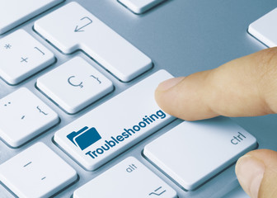
Case Study: Troubleshooting a Slow Computer
Troubleshoot the problem:
The computer is slow to start, applications take a long time to open, and it often freezes.

Slide 50
Brainstorm to prevent this problem:
1. Insufficient Memory (RAM). Upgrading the RAM may improve performance.
2. Malware or Viruses. Running an antivirus scan and removing any detected threats can improve performance.
3. Too Many Startup Programs. When too many applications launch during startup, it consumes system resources, slowing down the boot process and affecting overall performance. Disabling non-essential startup programs can help.
4. Overheating. Cleaning dust from the internal fans and ensuring proper airflow can prevent overheating.
5. Old or Failing Hardware. Aging hardware, such as a hard drive nearing the end of its life, can result in slow performance and frequent freezing. Upgrading to a solid-state drive (SSD) or replacing faulty components may be necessary.

Slide 51
Group Presentation
Research the different components of computer in a group (e.g., CPU, GPU, RAM, Hard Drive) . Present:
The component’s function.
How it works with other parts of the computer.
Interesting facts about that component (e.g., new technologies or innovations).

Slide 52

Role-Playing: "Be the Technician"
Create a dialogue on this scenario where you will act as computer technicians diagnosing issues “The computer is overheating. What could be wrong?” or “The screen isn’t displaying anything, and the fan is very loud. What should you check?” Work in pairs or groups to suggest solutions.

Slide 53
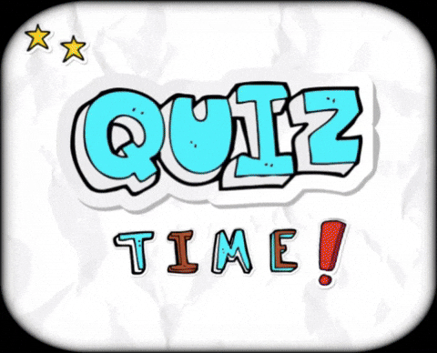
Let’s wrap-up with quizzes! https://quizizz.com/admin/quiz/5b987565ea47280019db6938/inside-a-computer

Slide 54

Create a Computer Component Ad Use creativity to apply knowledge of computer parts. Design an advertisement (social media ad) for a specific computer component, highlighting its features and why someone should buy it.

Slide 55

Home Assignment
Write a detailed description of at least five major components inside a computer.
Explain their functions, how they work, and how they connect with other components. The components should include: CPU (Central Processing Unit), RAM (Random Access Memory), Motherboard, Power Supply, Cooling Systems (Fans, Heat Sinks)

Slide 56


